Slide 1

Virtual Memory Impl.
PASS
CS532: OS Foundations
Lab Assignment
Email: chitram2@pdx.edu

Slide 2
Instructions: Make a copy of this document, move your copy to your submissions folder and fill the document with your responses. Use the space on each slide to show your responses, and add additional slides as needed.
When ready for grading: complete the lab assignment submission form and include a link to your filled document

Slide 3
vmstat utility and mem program
For this assignment use babbage.cs.pdx.edu so that you can run the vmstat utility.
When logged into babbage.cs.pdx.edu use the man command to learn about vmstat.
Also, go to the vm-beyondphys sub-directory within your ostep-homework directory, read the README.md file there and follow its instructions to build and test the ./mem program.

Slide 4
1. open two separate terminal connections to babbage.cs.pdx.edu. In one run vmstat 1 and leave it running. In the other window, run the mem program with varying inputs between 1 and 10000.
A. How do vmstat’s CPU usage stats change when running mem?
B. How do the vmstat CPU usage numbers change when running multiple, concurrent versions of mem?

Slide 5
A. How do vmstat’s CPU usage stats change when running mem?
us- time spent running user code (non-kernel). This increases as the ./mem program is started. This value fluctuates back and forth as we are iterating through the integer array and making computations.
sy - time spent running kernel code. This increases as the ./mem program is executed. New process gets created when program is launched. This causes kernel code to be executed and hence increase in system time. During execution this value remains almost constant. When the program ends the kernel processes end and hence decrease in value of this field.
id - this is the idle time of the CPU. This is slightly high before and after program execution. During execution the idle time goes low as expected.

Slide 6
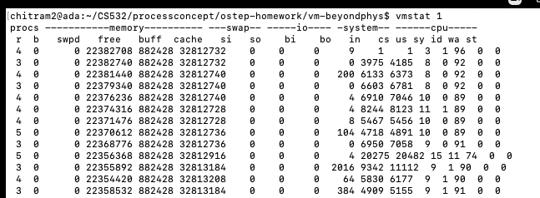
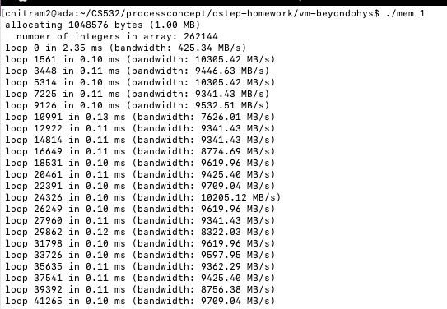

Slide 7
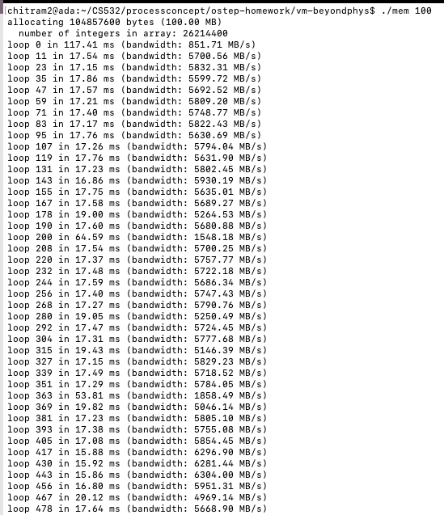

Slide 8
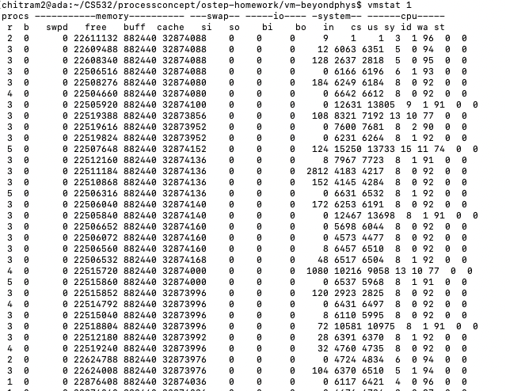

Slide 9
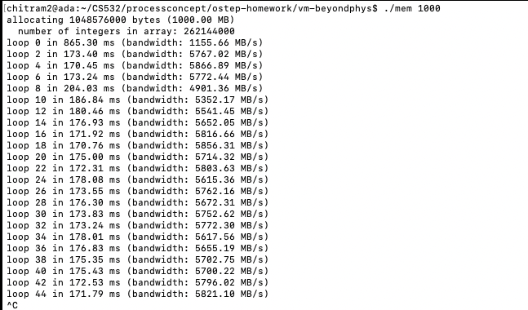

Slide 10
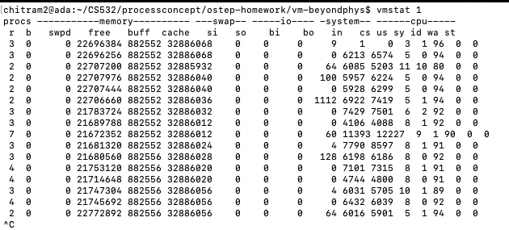

Slide 11
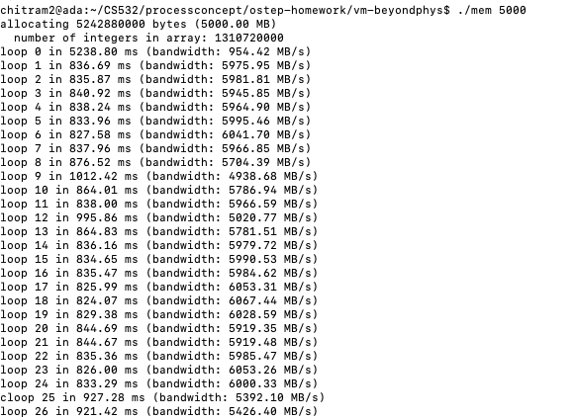

Slide 12
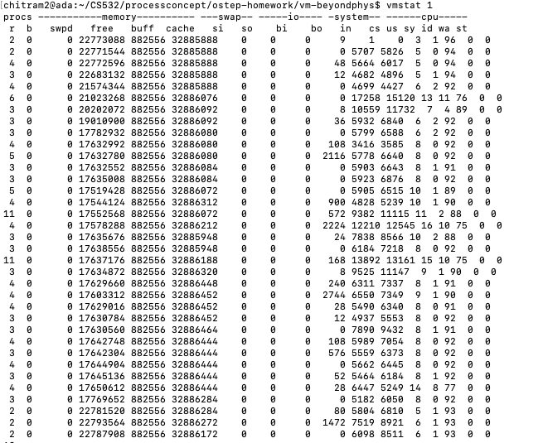

Slide 13
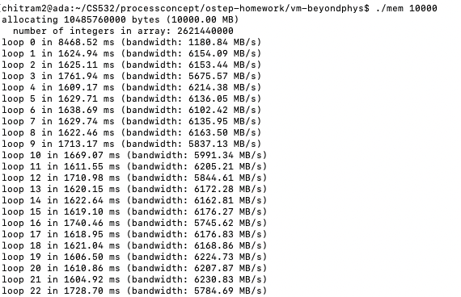

Slide 14
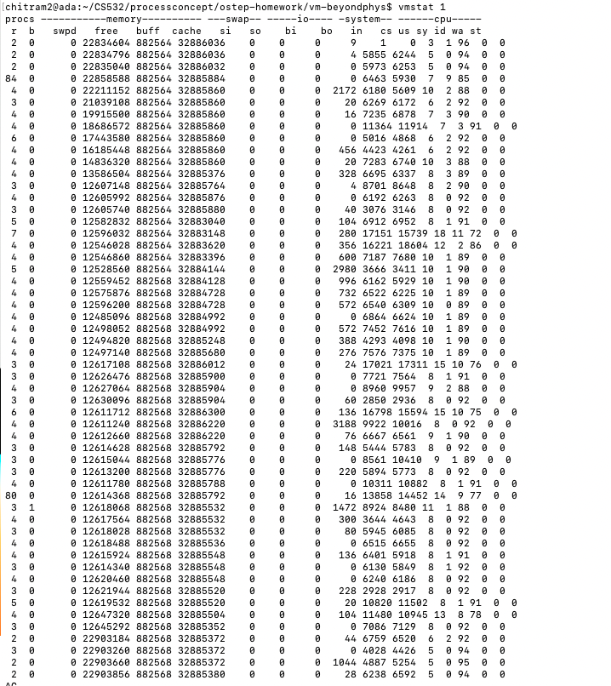

Slide 15
2. focus on vmstat’s free column (the amount of idle memory). Run ./mem 1024 (which allocates 1024 MiB) and watch how this value changes.
A. What do you notice about the free value after you start running mem?
As seen in the screenshots in following slides, the free value decreases after program starts running. It reduces roughly by 1024Mb.
B. How does this metric change when/after you terminate mem ?
After program termination the free value increases back to initial value. It increases back again by 1Gb.

Slide 16
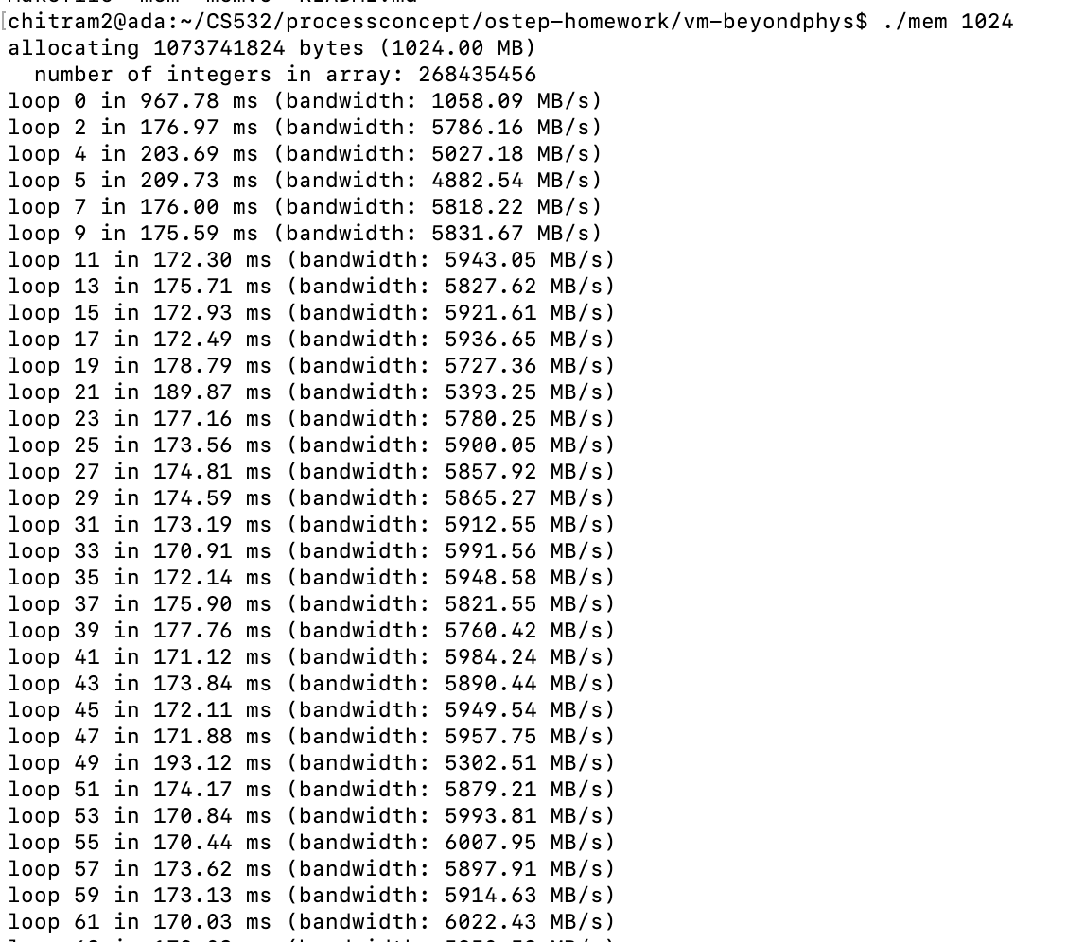

Slide 17
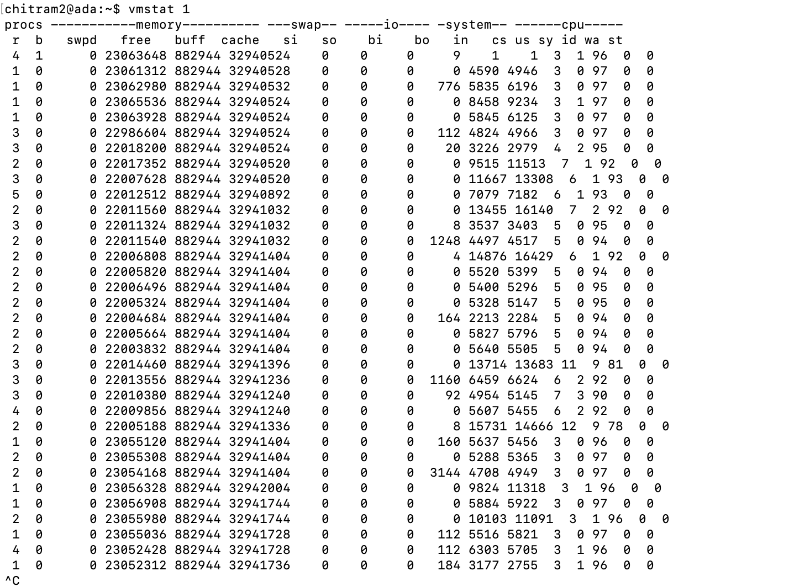

Slide 18
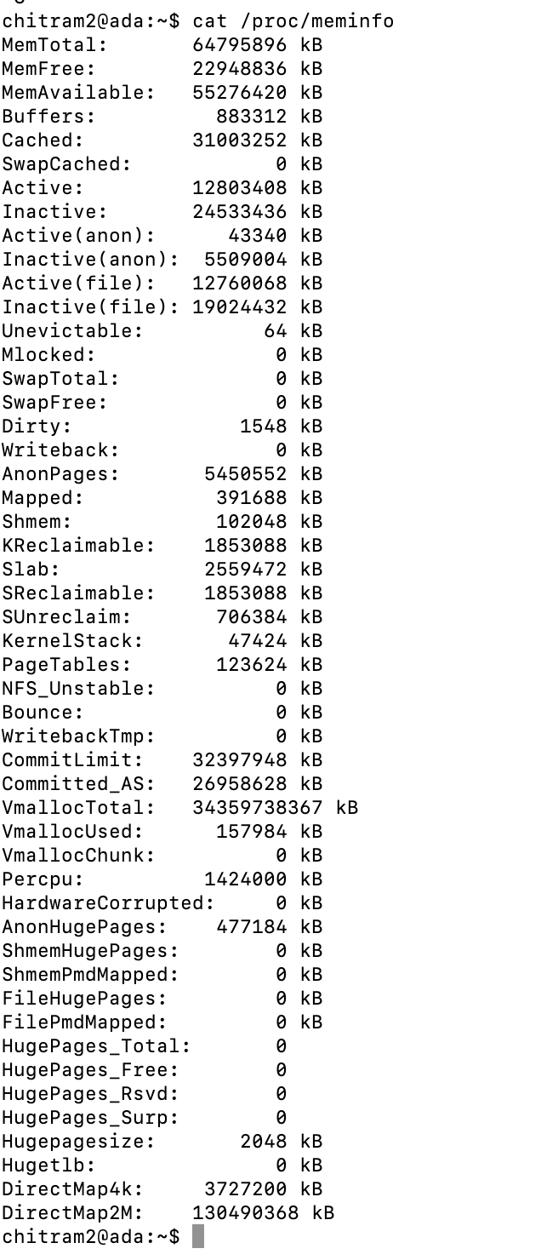
3. A. How much physical memory is configured on your machine (cat /proc/meminfo to find this value) - 64 Gb of memory is configured..

Slide 19
B. view the vmstat CPU usage metrics and the block I/O metrics. How do they change while mem is running?
I/O stats:
bi – Blocks received from a block device per second. This value is mostly a 0 meaning no blocks received from the disk IO
bo – Blocks sent to a block device per second. This value fluctuates from 0 to a high value (112 to 3144). As the program is running there are transfers to the disk from memory.
Cpu stats:
us – User time. The user time (us) time spent running user code (./mem program) increases once program is kicked off and reached a higher value and remains there till program runs and once program is killed it reduced back to original as expected
sy – System time. The system time or kernel code time (sy) increases when program is kicked off as it spawns new processes and then it fluctuates maybe due to page faults etc and program termination. Then goes back to initial value after program terminates.
id – Idle time. Cpu idle time (id) goes down once program starts running. It goes to original value after program killed.
Reference: https://phoenixnap.com/kb/vmstat-command and https://docs.oracle.com/cd/E19455-01/805-7229/6j6q8svh5/index.html

Slide 20
4. The mem program prints useful performance information after each iteration. Use them to fill the following table.
./mem <arg> | ms for loop 0 | ms for subsequent loops (approx) | Bandwidth for loop 0 (MB/s) | Bandwidth for subsequent loops MB/s (approx)
1000 | 2035 | 175 | 491 | 5500
2000 | 3923 | 340 | 509 | 5700
4000 | 3967 | 670 | 1008 | 5800
8000 | 7052 | 1300 | 1134 | 6000
16000 | 14226 | 2600 | 1124 | 6100
32000 | 60299 | 5600 | 530 | 5800

Slide 21
4 (cont)
A. does the steady state bandwidth (that is the bandwidth of subsequent loops after loop 0) vary much from input size to input size?
No, this doesn’t vary much from size to size. It remains in the 5500 to 6100 MB/s range.
B. did you notice any large variations in vmstat behavior/metrics across various mem input sizes?
The free memory reduced as per the mem input size. But, the other parameters in the CPU, system and block I/O remained similar.

Slide 22
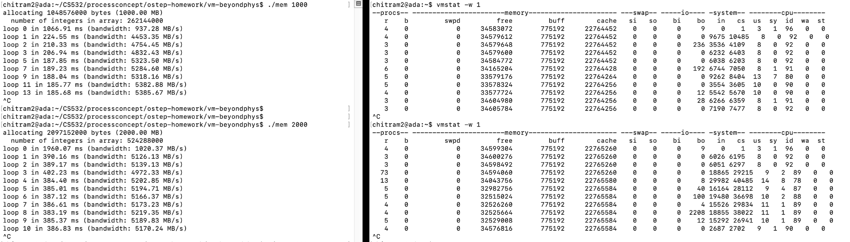
Screenshots

Slide 23
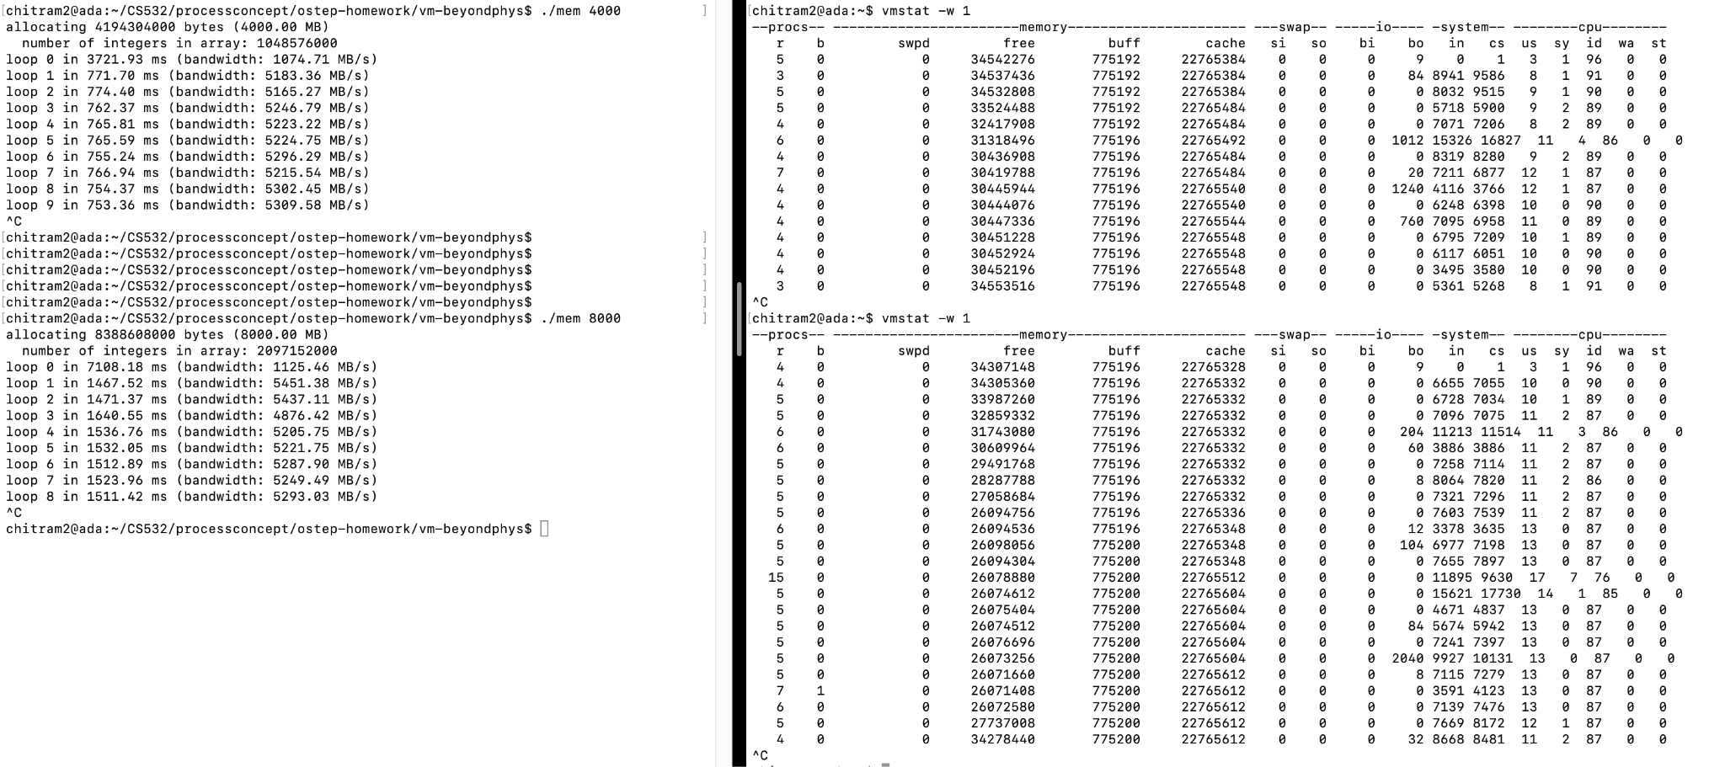

Slide 24
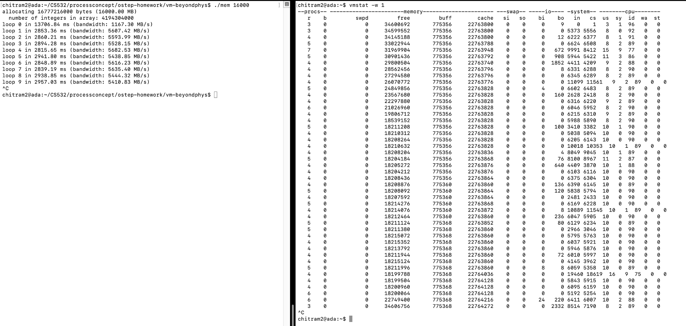

Slide 25
